Slide 1
ALGEBRA 4
Day 46

Slide 2
Bell Work:
When x = 3 and y = 5, by how much does the value of 3x² – 2y
exceed the value of 2x² – 3y ?
3
14
17
20
51

Slide 3
From Last Time
Page 293 #1-6, 7-23 (odd), 27-31 (odd)

Slide 4
5.3 Solving Polynomial Equations
Objectives:
To Solve Polynomials by Factoring.
To Solve Polynomials by Graphing.

Slide 5
Steps to Solving Polynomial Equations by Factoring:
1.) Write original equation
2.) Rewrite in standard form
3.) Factor completely (with the goal of getting down to at least a quadratic so you can use the formula if it doesn’t factor further)
4.) Use Zero Product Property
5.) Check Solutions in Original Equation

Slide 6

Example 1: Solve the following Polynomial.
$$3x^{4}+12x^{2}=6x^{3}$$

Slide 7
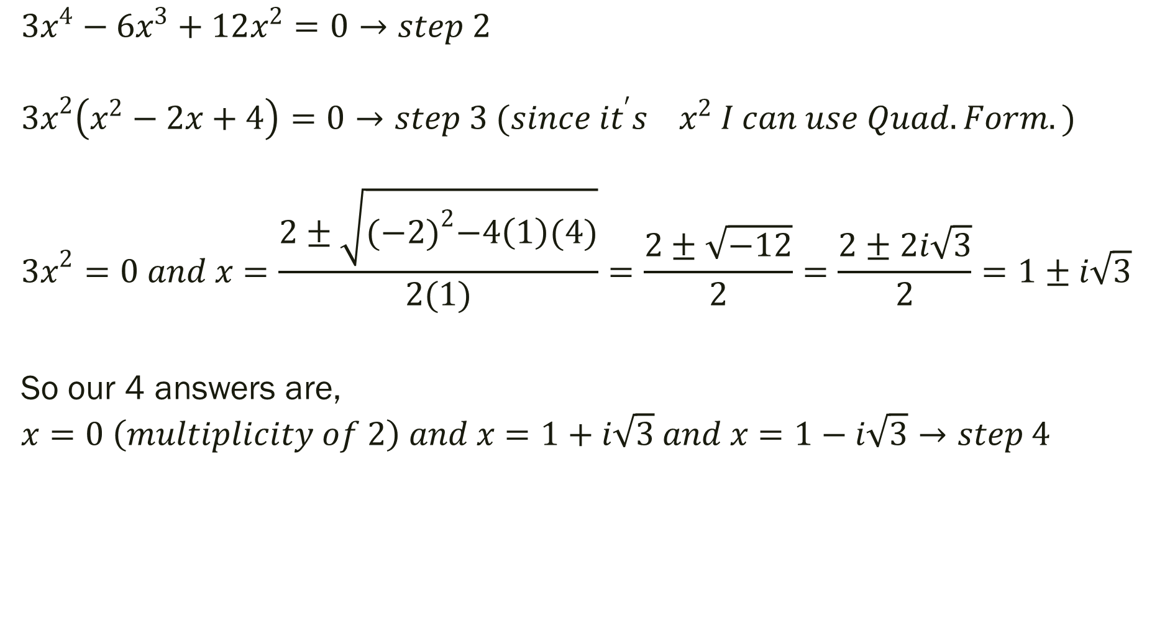
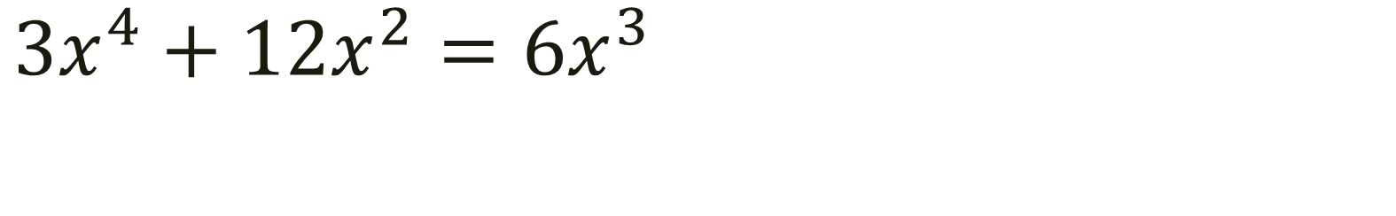
$$3x^{4}+12x^{2}=6x^{3}$$
$$3x^{4}−6x^{3}+12x^{2}=0→step 2$$
$${3x}^{2}\left(x^{2}−2x+4\right)=0→step 3 (since it^{′}s{ x}^{2} I can use Quad.Form.)$$
$${3x}^{2}=0 and x=\frac{2±\sqrt{{(−2)}^{2}−4\left(1\right)(4)}}{2(1)}=\frac{2±\sqrt{−12}}{2}=\frac{2±2i\sqrt{3}}{2}=1±i\sqrt{3}$$
So our 4 answers are,
$$x=0 \left(multiplicity of 2\right) and x=1+i\sqrt{3} and x=1−i\sqrt{3}→step 4$$

Slide 8
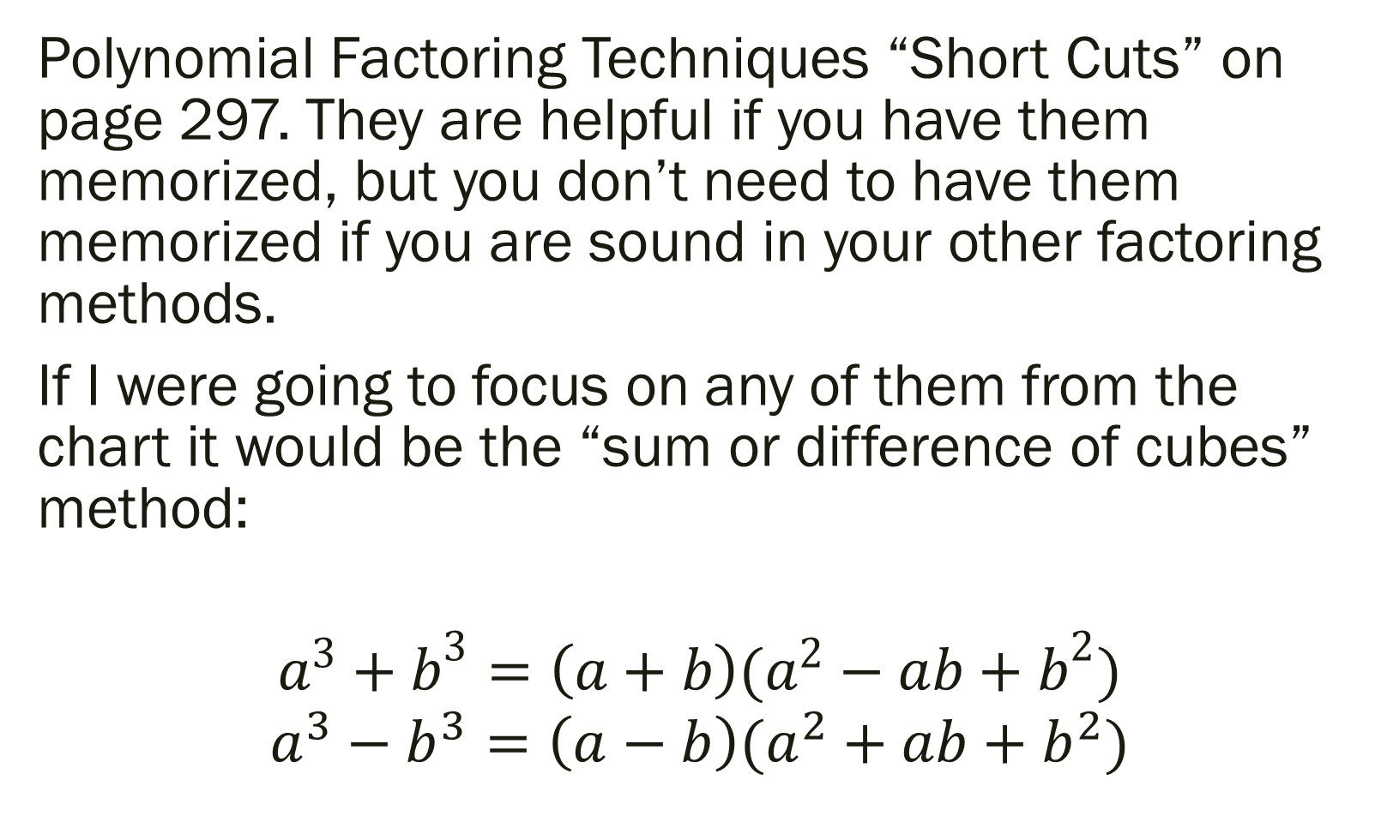
Polynomial Factoring Techniques “Short Cuts” on page 297. They are helpful if you have them memorized, but you don’t need to have them memorized if you are sound in your other factoring methods.
If I were going to focus on any of them from the chart it would be the “sum or difference of cubes” method:
$$a^{3}+b^{3}=\left(a+b\right)(a^{2}−ab+b^{2})$$
$$a^{3}−b^{3}=\left(a−b\right)(a^{2}+ab+b^{2})$$

Slide 9

Example 2: Factor
$${8x}^{3}+1$$

Slide 10

Factor
$$a^{3}+b^{3}=\left(a+b\right)(a^{2}−ab+b^{2})$$
a = 2x b = 1
$${8x}^{3}+1=\left(2x+1\right)({4x}^{2}−2x+1)$$

Slide 11

Example 3: Finding Real Roots by Graphing.
$$x^{3}−2=3x^{2}+7x$$

Slide 12
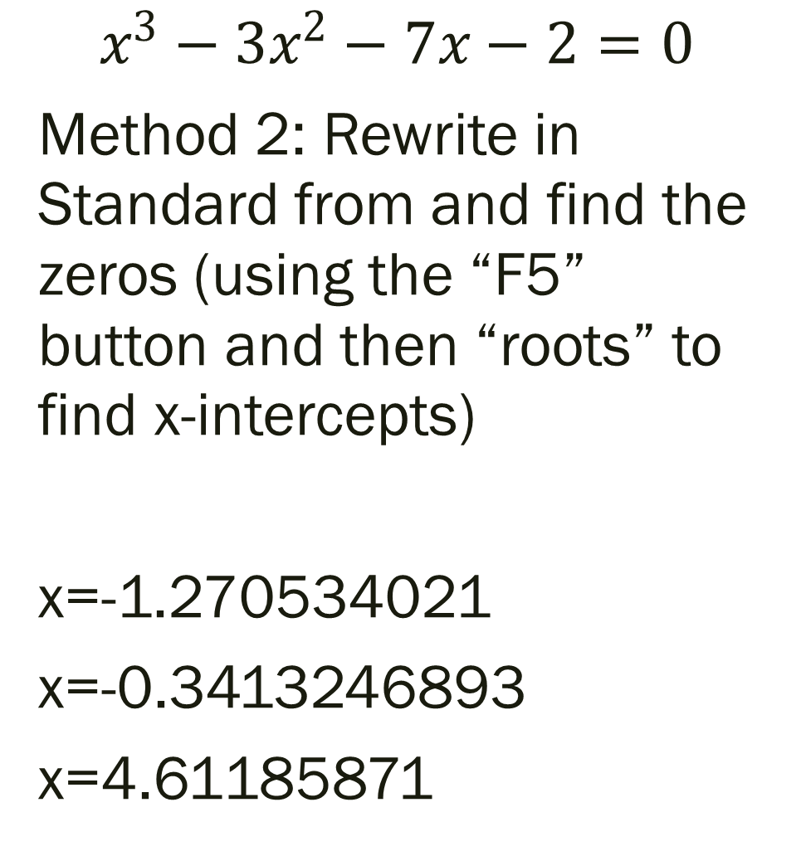

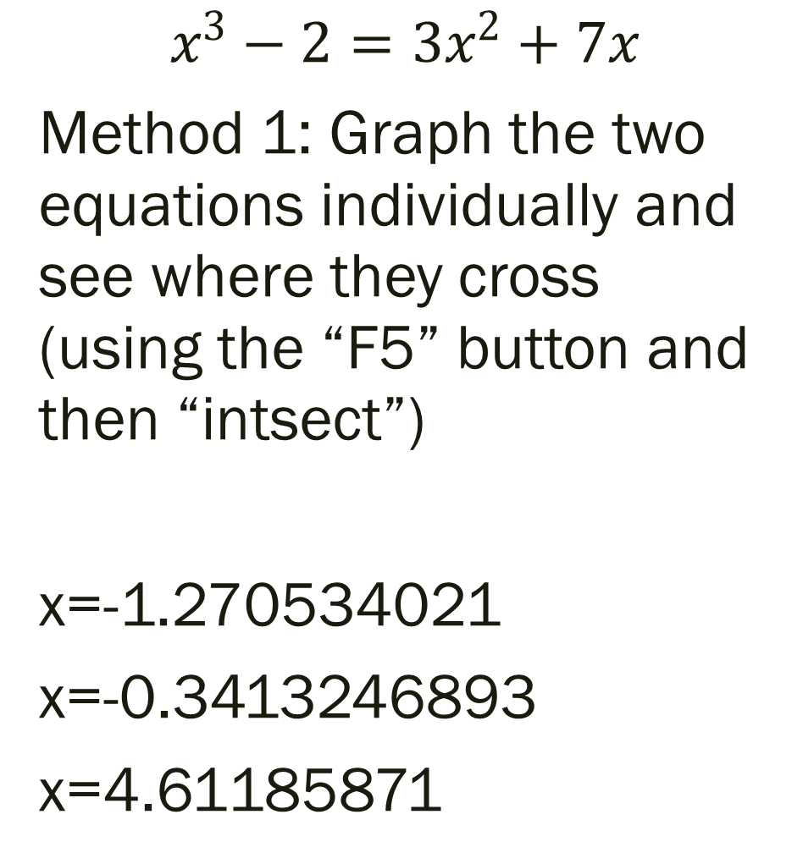
$$x^{3}−2=3x^{2}+7x$$
$$x^{3}−3x^{2}−7x−2=0$$
Method 2: Rewrite in Standard from and find the zeros (using the “F5” button and then “roots” to find x-intercepts)
x=-1.270534021
x=-0.3413246893
x=4.61185871
$$x^{3}−2=3x^{2}+7x$$
Method 1: Graph the two equations individually and see where they cross (using the “F5” button and then “intsect”)
x=-1.270534021
x=-0.3413246893
x=4.61185871

Slide 13
For Next Time
page 300 #1-9, 17, 25-31 (odd), 37, 51-52

